Slide 1


Data Modeling Methodology for MongoDB
Entities
Identify the entities
Describe their properties
Workloads
Qualify the operations
Quantify the operations
Relationships
Identify and quantify
Embed or reference
Patterns
Optimize the schema
Avoid antipatterns
- 1 -

Slide 2

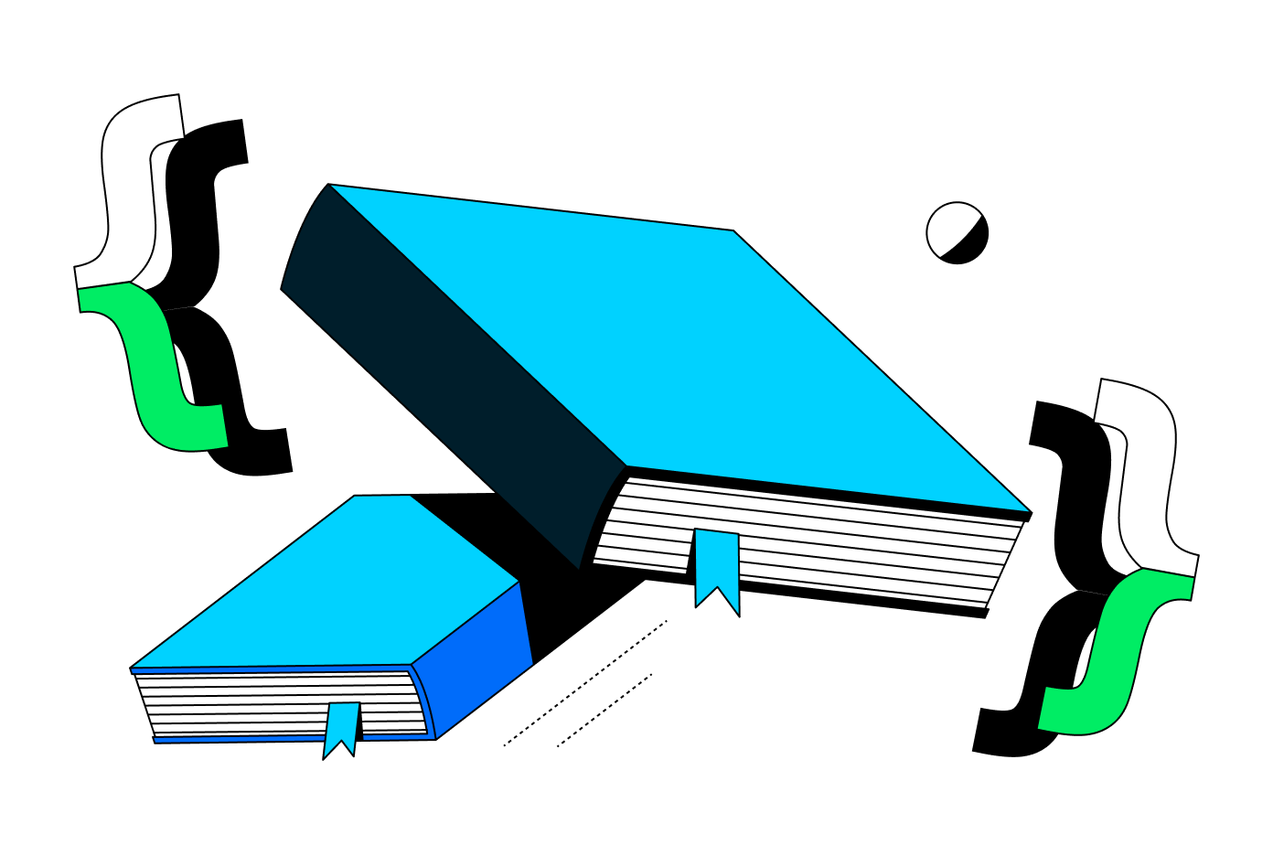
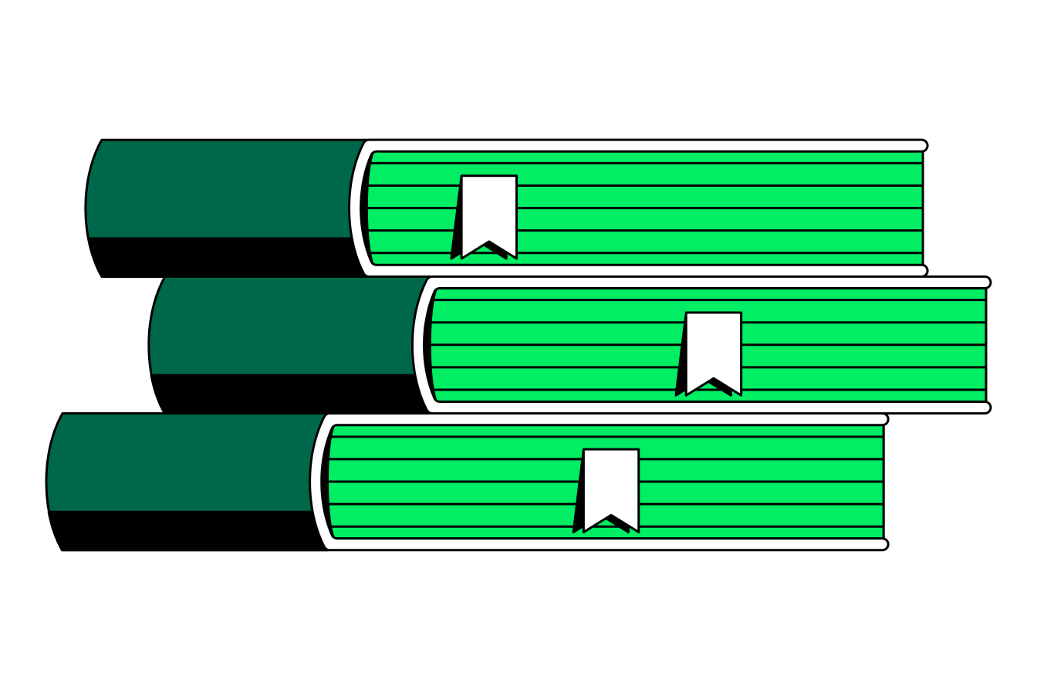


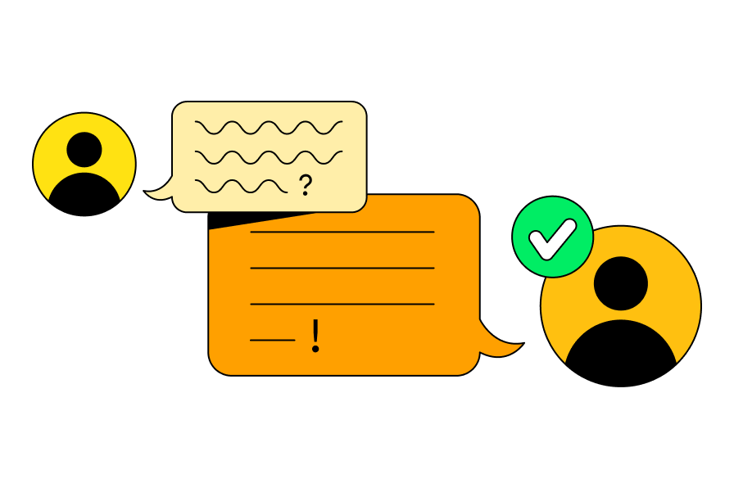

Exercise 1. Identify the library app entities
Instructions: Which entities would be part of this application? What are their properties and are they related to other entities? Refer to the application prototype for guidance: mdb.link/library. Complete the table below with entity names, their properties, and potential related entities.
Reservation
reservation date
Related Entities
Book
Book
ISBN
title
copies* number
cover image URL
description
Related Entities
Authors (many)
Book Loan
_______ date
due date
Related Entities
User loaned by
User borrowed by
address
email
biography
aliases
Related Entities
text
rating
date
Related Entities
Book
Publisher
name
country
Related Entities
* Advanced exercise to discuss in your group:
What is an alternative to a number of copies in the book, and what are the advantages and disadvantages of such solution?
- 2 -

Slide 3
Exercise 2. Determine the app workload
The library has 100,000 active users
Each user reserves an average of 3 books per month. Users can only reserve a book if copies are available in the library.
How often is the “create a reservation” operation performed?
____ users x __ reservations per user / 30 = ____ reservations per day
Reservations last for 12 hours. Only half of the reservations actually result in loans.
How many loan documents are created every day?
_______ x _______ = _______ loans per day
How many reservations expire every day?
_______ x _______ = _______ expired reservations per day
Expired reservations are deleted, but book loans are persisted as historical records.
Advanced question: Which type of MongoDB index enables the automatic deletion of expired reservations? __________
Users browse more books than they reserve. Assume that for every reservation, users browse an average of 50 books.
How often is the “fetch book details” operation performed?
_______ x _______ reservations per day = _______ “fetch book details” ops per day
On average, 100 new books are added to the catalogue each month.
What is the 5-year growth in the number of books?
_______ x _______ x _______ = _______ new books in 5 years
The application has functionality showing an authors page with all the books the author has written. Assume that the author details pages are visited 10 times less often than book details pages.
How often is the “fetch author details” operation performed?
_______ ÷ _______ = _______ “fetch author details” operations per day
20% of users leave a review after returning a book. Some popular books, which the library has multiple copies of, are read at least 1,000 times per month, though the actual number could be higher.
How many reviews does a popular book get per month?
_______ x _______ = _______ reviews per month
What is the annual growth in the number of reviews for a popular book?
_______ x _______ = _______ reviews per year
Application workload insights
Is the workload read-heavy or write-heavy? | ☐ read-heavy ☐ write-heavy
What is the most frequent operation in the application? | ☐ fetch book ☐ fetch author
Based on the frequency of operations in the application, should the data model be optimized for books queries or authors queries? | ☐ optimized for book queries ☐ optimized for author queries
Does the number of reviews on popular books grow without bound (continue to increase indefinitely)? | ☐ yes ☐ no
- 3 -

Slide 4
Exercise 3. Model the relationships
Instructions: For each relationship, consider the guideline questions above the table and then:
1. Determine the type of the relationship: one-to-one, one-to-few (low cardinality), one-to-many, one-to-zillions (high cardinality), many-to-many, etc.
2. Decide whether to use embedding or referencing.
3. Specify which side of the relationship should store the embedded data or references.
Go together: Do the pieces of information express a "has-a," "contains," or similar relationship? Document growth: If embedding, would the embedded piece grow without bound?
Relationship | Type | Go together? | Document growth? | Embed or reference? | Which side?
User - Contact information (object with email and address) |  | Yes / No | Yes / No
Author - Author alias |  | Yes / No | Yes/No
High cardinality: Does the “many” side of the relationship contain a large or rapidly growing number of unique values?
Relationship | Type | High cardinality? | Embed or reference? | Which side?
Book - Review |  | Yes / No
User - Loan |  | Yes / No
Accessed separately: Are the related entities frequently accessed separately?
Relationship | Type | Accessed separately? | Embed or reference? | Which side?
User - Reservation | one-to-many | Yes / No
Book - Reservation | one-to-many | Yes / No
The app has book and author details pages. You established in the previous exercise that the book page is queried more often than the author page. Based on this, how would you model this relationship?
Relationship | Type | Embed or reference? | Which side?
Book - Author
The app needs to support filtering books by publisher. Only the publisher's name and country must be stored and no other functionality involves publishers. Based on this, how would you model this relationship?
Relationship | Type | Embed or reference? | Which side?
Book - Publisher
- 4 -

Slide 5


Embedding vs Referencing Guidelines
Guideline Name | Question | Embed | Reference
Simplicity | Would keeping the pieces of information together lead to a simpler data model and code? | Yes
Go Together | Do the pieces of information express a "has-a," "contains," or similar relationship? | Yes
Query Atomicity | Does the application query the pieces of information together? | Yes
Update Complexity | Are the pieces of information updated together? | Yes
Archival | Should the pieces of information be archived at the same time? | Yes
Cardinality | Is there a high cardinality (current or growing) in a "many" side of the relationship? | No | Yes
Data Duplication | Would data duplication be too complicated to manage and undesired? | No | Yes
Document Size | Would the combined size of the pieces of information take too much memory or transfer bandwidth for the application? | No | Yes
Document Growth | Would the embedded piece grow without bound? | No | Yes
Workload | Are the pieces of information written at different times in a write-heavy workload? |  | Yes
Individuality | For the children side of the relationship, can the pieces exist by themselves without a parent? |  | Yes
Schema Design Anti-Patterns
Unbounded arrays
Bloated documents
Massive number of collections
Unnecessary indexes
Separating data that is accessed together
Case-insensitive queries without case-insensitive indexes
- 5 -

Slide 6
Solutions to exercise 1. Identify the library app entities
Reservation
reservation date
expiration date
Related Entities
User
Book
Book
ISBN
title
copies* number
cover image URL
description
year
language
Related Entities
Publisher
Authors (many)
Book Loan
reservation date
due date
Related Entities
User loaned by
User borrowed by
Book
User
name
address
email
role “reader”, “librarian”
Author
name
biography
aliases
Related Entities
Books (many)
Review
text
rating
Related Entities
Book
User reviewer
Publisher
name
country
Related Entities
Books (many)
Alternatively, you can model “Book Copy” as a separate entity instead of tracking the number of copies as a property of a book.
This would allow tracking of individual copies, including their condition and lending history. However, this approach may be unnecessary for simpler systems. Whether this is the right approach depends on your system requirements.
- 6 -

Slide 7
Solutions to exercise 2. App workload
The library has 100,000 active users
Each user reserves an average of 3 books per month. Users can only reserve a book if copies are available in the library.
How often is the “create a reservation” operation performed?
100,000 users x 3 reservations per user per month / 30 = 10,000 reservations per day
Reservations last for 12 hours. Only half of the reservations actually result in loans.
How many loan documents are created every day?
10,000 reservations x 50% converted to loans = 5,000 loans per day
How many reservations expire every day?
10,000 reservations x 50% expired = 5,000 expired reservations per day
Expired reservations are deleted, but book loans are persisted as historical records.
Advanced question: Which type of MongoDB index enables the automatic deletion of expired reservations? TTL (time-to-live) index
Users browse more books than they reserve. Assume that for every reservation, users browse an average of 50 books.
How often is the “fetch book details” operation performed?
50 browsed books x 10,000 reservations per day = 500,000 “fetch book details” ops per day
On average, 100 new books are added to the catalogue each month.
What is the 5-year growth in the number of books?
100 new books x 12 months x 5 years = 6,000 new books in 5 years
The application has functionality showing an authors page with all the books the author has written. Assume that the author details pages are visited 10 times less often than book details pages.
How often is the “fetch author details” operation performed?
500,000 “fetch book details” ÷ 10 = 50,000 “fetch author details” operations per day
20% of users leave a review after returning a book. Some popular books, which the library has multiple copies of, are read at least 1,000 times per month, though the actual number could be higher.
How many reviews does a popular book get per month?
1,000 reads per month x 20% = 200 reviews per month
What is the annual growth in the number of reviews for a popular book?
200 reviews per month x 12 months = 2,400 reviews per year
Application workload insights
Is the workload read-heavy or write-heavy? | The workload is read-heavy.
What is the most frequent operation in the application? | “Fetch book details” — 500,000 ops/day.
Based on the frequency of operations in the application, should the data model be optimized for books queries or authors queries? | Book queries because they are more frequent than author queries.
Does the number of reviews on popular books grow without bound (continue to increase indefinitely)? | Yes, while the growth rate may not be very high, there’s no upper limit.
- 7 -

Slide 8
Solutions to exercise 3. Model the relationships
Go together: Do the pieces of information express a "has-a," "contains," or similar relationship? Document growth: If embedding, would the embedded piece grow without bound?
Relationship | Type | Go together? | Document growth? | Embed or reference? | Which side?
User - Contact information (object with email and address) | one-to-one | Yes | No | Embed | User
Author - Author Alias | one-to-few | Yes | No | Embed | Author
High cardinality: Does the “many” side of the relationship contain a large or rapidly growing number of unique values?
Relationship | Type | High cardinality? | Embed or reference? | Which side?
Book - Review | one-to-many | Yes | Reference* | Review
User - Loan | one-to-many | Yes | Reference* | Loan
Accessed separately: Are the related entities frequently accessed separately? You can assume that expired reservations are deleted daily to optimize storage costs.
Relationship | Type | Accessed separately? | Embed or reference? | Which side?
User - Reservation | one-to-many | Yes | Reference* | Reservation
Book - Reservation | one-to-many | Yes | Reference* | Reservation
The app has book and author details pages. You established in the previous exercise that the book page is queried more often than the author page. Based on this, how would you model this relationship?
Relationship | Type | Embed or reference? | Which side?
Book - Author | many-to-many | Reference* | Book
The app needs to support filtering books by publisher. Only the publisher's name and country must be stored and no other functionality involves publishers. Based on this, how would you model this relationship?
Relationship | Type | Embed or reference? | Which side?
Book - Publisher | many-to-one | Embed | Book
* This relationship can be optimized if needed with a MongoDB schema design pattern.
- 8 -

